Slide 1



Department of Computer Science and Engineering
IPL MATCH WINNER PREDICTION
Mrs. Divya M,
Department of CSE
Rajalakshmi Engineering College Chennai, India
2116220701237
SAI RUTHWIK V C V N

Slide 2
Problem Statement and Motivation
Problem Statement:
Predicting the outcome of an IPL (Indian Premier League) match is a complex task due to numerous influencing factors such as player performance, team composition, venue, and toss decisions.
Traditional methods often rely on expert opinions or historical trends, which may lack accuracy and adaptability.
Motivation:
The IPL is one of the most followed cricket leagues globally, generating vast amounts of data.
Accurate prediction models can benefit sports analysts, fans, and fantasy league players.
Applying machine learning provides a data-driven, unbiased approach to make informed predictions.
Enhances understanding of the impact of key match factors through data analysis.
Second Review
Department of Computer Science and Engineering
2

Slide 3
Existing System
Existing System Overview:
Most existing IPL match predictions are based on:
Expert opinions, which can be subjective and inconsistent.
Historical win percentages, without factoring in real-time match dynamics.
Manual analysis of team/player stats, which is time-consuming and limited in accuracy.
Limitations of Existing System:
Lacks adaptability to real-time data like player form or match conditions.
Doesn't utilize the full potential of historical data and statistical features.
Predictions may be biased and non-repeatable.
Zeroth Review
Department of Computer Science and Engineering
3

Slide 4
Objectives
To develop a machine learning model that accurately predicts the winner of an IPL match.
To analyze key features such as venue, teams, and match history.
To utilize historical IPL data and transform it into meaningful inputs for prediction.
To implement a Random Forest Classifier for efficient and accurate classification.
To design a user-friendly interface for predicting match outcomes.
To evaluate model performance using metrics like accuracy and confusion matrix.
Second Review
Department of Computer Science and Engineering
4

Slide 5
Abstract
This project aims to predict the outcome of IPL matches using machine learning techniques, specifically the Random Forest Classifier. The system analyzes various match-related factors such as team names, venue, toss decisions, and historical match data to determine the likely winner. By leveraging past IPL datasets, the model learns patterns and trends that influence match results. A web-based interface is also developed to allow users to input match details and receive instant winner predictions. This project not only showcases the power of data analytics in sports but also highlights how machine learning can offer insights into complex decision-making scenarios like match predictions.
Second Review
Department of Computer Science and Engineering
5

Slide 6
Proposed System
Proposed System Overview:
The proposed system predicts the winning team of an IPL match using machine learning.
It uses a Random Forest Classifier, trained on historical IPL match data.
The model takes key input features such as:
Batting and bowling team
Venue
Toss winner and toss decision
Match date
A Flask-based web interface is developed for users to enter match details and receive real-time predictions.
Zeroth Review
Department of Computer Science and Engineering
6

Slide 7
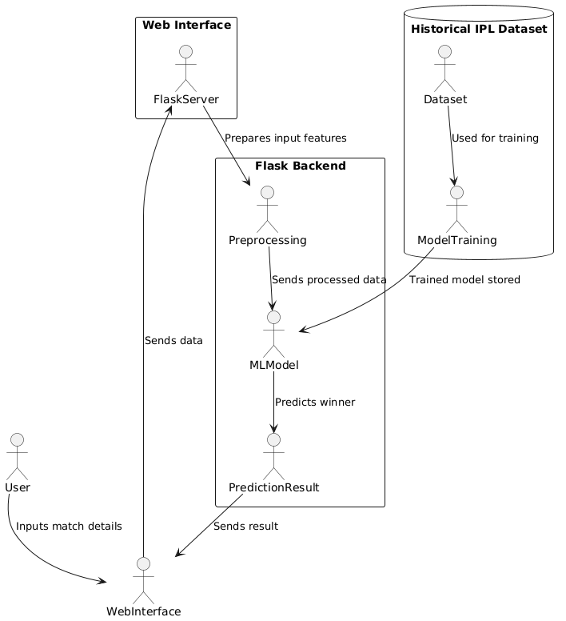
System Architecture
User inputs details via Web Interface
Flask Backend handles preprocessing and prediction
MLModel is a trained Random Forest Classifier
Dataset used in the training phase
Second Review
Department of Computer Science and Engineering
7

Slide 8
List of Modules
User Interface Module
Frontend (React or HTML/CSS)
Collects input from users (team names, venue, toss winner, etc.)
Flask Backend Module
Handles routing, request processing, and connects frontend to ML model
Sends user inputs to the prediction logic
Data Preprocessing Module
Encodes categorical features (e.g., team names, venue)
Normalizes and transforms data to the format expected by the model
Machine Learning Module
Random Forest Classifier trained on historical IPL data
Performs the prediction based on processed inputs
Prediction Display Module
Receives output from the ML model
Displays the predicted winner to the user
Second Review
Department of Computer Science and Engineering
8

Slide 9
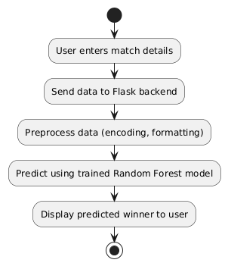
Functional Description for each modules with Activity Diagram
User Interface Module – Collects match details from the user through a simple web form.
Flask Backend Module – Receives user input and routes it to the preprocessing and model components.
Preprocessing Module – Converts and formats the input data into a machine-readable form.
Machine Learning Module – Uses a trained Random Forest model to predict the winning team.
Prediction Output Module – Sends the predicted result back to the frontend for user display.
Activity Diagram
Second Review
Department of Computer Science and Engineering
9

Slide 10
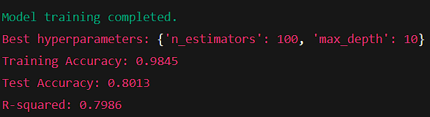
Implementation & Results of Module
The system efficiently transforms input data, runs the prediction, and displays the result in real-time. With an accuracy of around 80%, the model shows strong performance on test data, making the application both responsive and reasonably reliable for match outcome forecasting.
Second Review
Department of Computer Science and Engineering
10

Slide 11
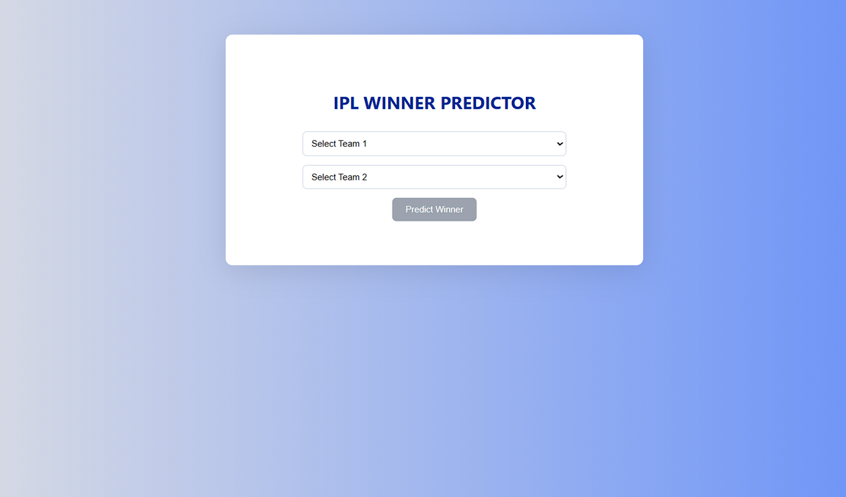
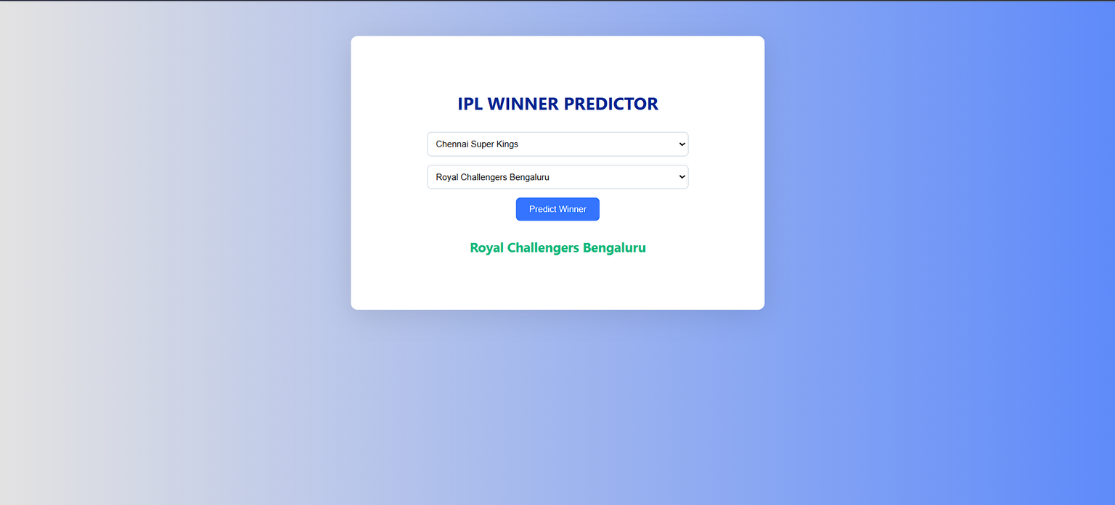
Implementation & Results of Module
Second Review
Department of Computer Science and Engineering
10

Slide 12
Conclusion & Future Work
Conclusion:
The IPL Match Winner Prediction system successfully demonstrates how machine learning can be applied to sports analytics. Using historical data and a Random Forest classifier, the model achieved strong prediction accuracy, providing users with fast and data-driven match outcome forecasts through a simple web interface.
Future Work:
In the future, the model can be enhanced by including real-time player statistics, weather conditions, and live match momentum data. Integration with live APIs, model retraining with newer IPL seasons, and exploring advanced models like XGBoost or deep learning could further improve prediction accuracy and make the system more dynamic and insightful.
Second Review
Department of Computer Science and Engineering
11

Slide 13
References
Kaggle. Indian Premier League (IPL) Dataset. https://www.kaggle.com
Scikit-learn Documentation. Machine Learning in Python. https://scikit-learn.org
Flask Documentation. Lightweight Web Framework. https://flask.palletsprojects.com
Pandas Documentation. Data Analysis in Python. https://pandas.pydata.org
IPL Official Website. Match Schedules, Stats & Team Info. https://www.iplt20.com
Second Review
Department of Computer Science and Engineering
12

Slide 14

Paper Publication Status
Scan To View
YET TO BE PUBLISHED
Second Review
Department of Computer Science and Engineering
13

Slide 15
Thank You
Second Review
Department of Computer Science and Engineering
14

